Slide 1
Explaining Clusters of Temporal Anomalies
Notes:
Give a bit of context to the project setting

Slide 2
Motivation
(1) Clustering:
Temporal anomalies detected are high-dimensional and can have varying lengths
Anomalies will exhibit patterns that show different types of abnormal behaviour
No labels available that would identify different anomaly types
Clustering is needed to identify groups of anomalies that reflect different kinds of anomalous behavior
(2) Explainability:
Anomalies need to be visually inspected individually, so only a small number of anomalies can be validated
Explanations of anomaly signatures can help SMEs in the validation process: 1) Reduce validation time and 2) Better understanding of contributing factors
Clustering needs to be enhanced with explainability methods to generate intuitive explanations
Limited work on explainability for time series
European Columbus Laboratory

Slide 3
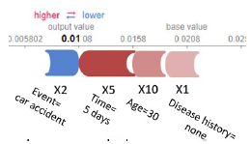
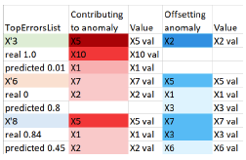
Prior Work
Representation Learning for Clustering Temporal Anomalies (Ioana)
Explaining Anomalies Detected by Autoencoders Using SHAP (Antwarg, Liat, et al. 2020)
Anomalies have a high reconstruction error
Game-theory based explanation framework SHAP used to explain anomalies
SHAP values computed for features with highest reconstruction errors using Kernel SHAP
Identify features that are most important in affecting reconstruction error
Negative SHAP values contribute to the anomalies
Positive SHAP values offset the anomalies

Slide 4
Approach
Temporal anomalies detected by the anomaly detection pipeline
Clustering of the anomalies with encoder and k-means
Autoencoder attempts to learn most representative embeddings and tries to minimize the reconstruction error
Trained autoencoder model and cluster labels for anomalies are fed into an explainability model to generate explanations per cluster
Dilated Causal CNN Encoder
Dilated Causal CNN Autoencoder
1
2
Learnt representations
Trained model based on reconstruction errors of anomalies
k-means clustering
Explainability Model
Clusters of Anomalies
3
Explanations for clusters

Slide 5
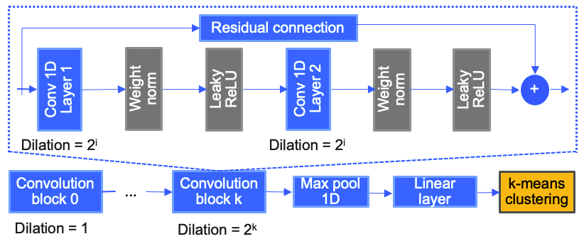
1. Dilated Causal CNN Encoder
Architecture:
Training:
Composed loss function that simultaneously optimizes both representation learning and clustering
Integration of silhouette score (cluster similarity measure) as 2nd optimization objective apart from the composed loss
Early stopping strategy based on silhouette score; during one optimization step:
Compute loss for generated representations
Fit k-means on representations and optimize number of clusters based on silhouette score
Compare score with previous score
Stop/continue training
Exponentially dilated stacked causal convolutions
More efficient than RNNs and better at capturing long-term dependencies in sequential data
Causal convolutions ensure that the output value at any time step is only computed using previous values until that time step
Output: Cluster labels of anomalies

Slide 6
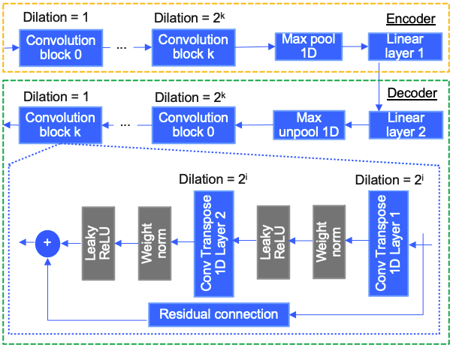
2. Dilated Causal CNN Autoencoder
Architecture:
Decoder that is symmetrical to the 1. causal encoder
Exponentially decreasing dilation sizes and reverse order of convolution blocks in the decoder
Reconstruction loss measured by Mean Squared Error (no composed loss function)
Output: Reconstruction loss of each anomaly (in a batch)

Slide 7
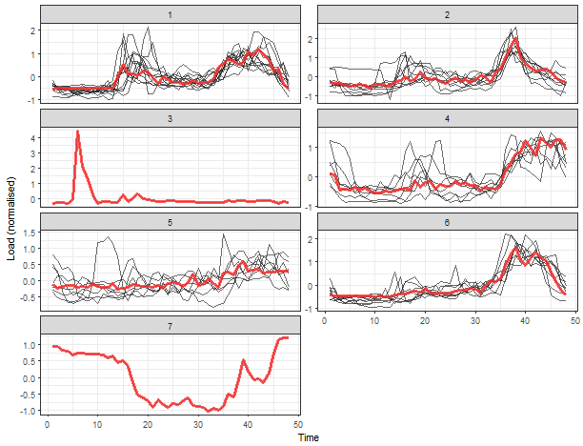
3. Explainability: Feature Explanations
Permutation Feature Importance:
Change in model performance is measured after input feature values are randomly shuffled
Feature is important if model error (reconstruction error) after permutation increases
Compute feature importance values for each sample within a cluster
SHapley Additive exPlanations Values (SHAP):
Shapley values from cooperative game-theory
Represent average contribution to a prediction of a single feature
Either positive or negative effect on prediction
Deep SHAP (DeepExplainer) is based on similarities between SHAP values and gradient-based explainer DeepLIFT
Average over samples in a cluster = Feature importance per cluster

Slide 8
3. Explainability: Feature Explanations
Actionability:
Anomaly requires action, potential customer complaint
Response time related metrics (system latency) are important
Non-actionability:
Transient issue, may not need a solution
I/O rate related metrics (workload change) are important
Select samples with response time in Top 5 most important features
Compute feature importance for new clusters
Put selected samples in a new cluster and remove from other clusters

Slide 9
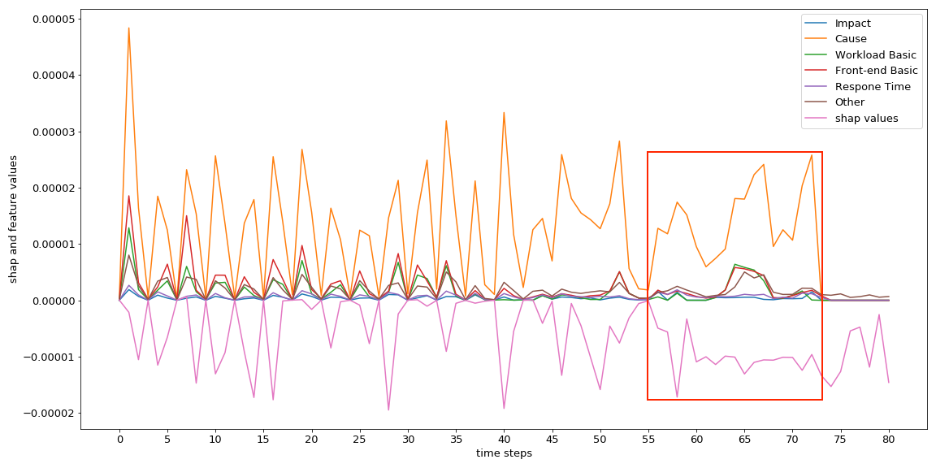
3. Explainability: Temporal Explanations
Explanations for specific time steps
Anomalies can be very long, but not all time steps are equally important
Identify consecutive time periods of an anomaly during which the anomalous behaviour is more significant
SHAP values are initially computed for every time step and every feature → Average over features to obtain importance per time step
Draw attention to specific parts of a long anomaly

Slide 10
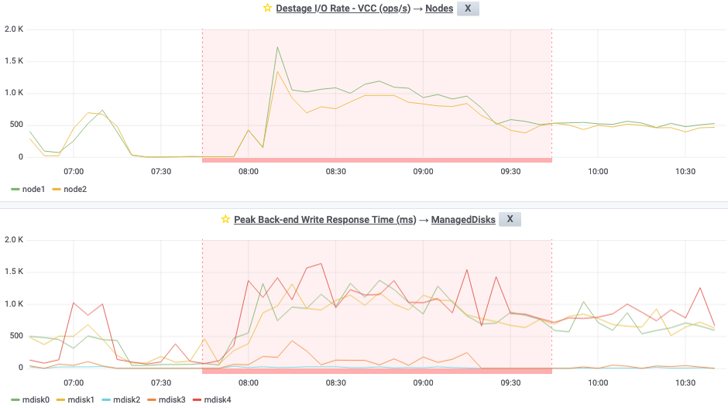
Data sets
Properties after Preprocessing and Feature Selection:
Data set | Anomalies | Features | Longest anomaly | Shortest anomaly | Average length
Validated | 83 | 84** | 1113 | 26 | 272 (≈ 22.6 hours )
Non-validated | 926 | 101** | 5552 | 25 | 652 (≈ 2.26 days )
Length in time steps (1 time step = 5min)
** Selection based on data distributions and feedback

Slide 11
Hyperparameter Optimization for the Encoder
Hyperparameter | Optimization range
Batch size | 26
Number of optimization steps | 1000, 2000, 3000, 4000
Learning rate | 0.01, 0.001, 0.0001, 0.00001
Channels | 40
Kernel size | 3
Channels in | 1
Channels out | 320
Reduced size | 160
Depth | 10
Compared length | 5, 10, 15, 20
Number of random samples | 5, 10, 15, 20
Early stopping | 5
Experiments run on VM with 25 GB RAM and 12 CPUs (2.4 GHz )
Brute force grid search for tuning 4 parameters; 4⁴ = 256 possible combinations
Computation time ∼ 4 days and 4 hours
During optimization, highest silhouette score on the test set from the validated data set: 0.7041
Remaining parameters set based on Unsupervised scalable representation learning for multivariate time series - Franceschi/Dieuleveut/Jaggi 2019
Autoencoder uses similar set of hyperparameters without compared length and random samples
Learning rate = 0.00001
Number of optimization steps = 1000
Batch size = 25
Evaluation

Slide 12
Clustering Results
Different training runs with different silhouette scores
Anomaly clusters are chosen based on:
Silhouette score
Number of clusters
Cluster structure (distribution of samples among clusters)
Validated data set |  |  | Non-validated data set
Silhouette score | Number of clusters | Cluster structure | Silhouette score | Number of clusters | Cluster structure
0.8344 | 2 | 73, 10 | 0.9732 | 2 | 925, 1
0.7878 | 2 | 72, 11 | 0.8880 | 3 | 781, 142, 3
0.7407 | 2 | 65, 18 | 0.8797 | 2 | 881, 45
0.7051 | 4 | 19, 41, 9, 14 | 0.8627 | 2 | 764, 162
Evaluation

Slide 13
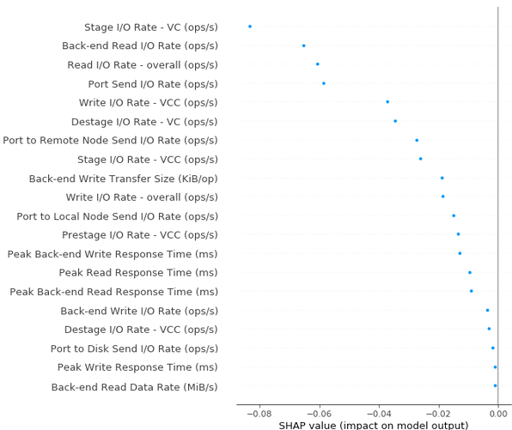
Explainability with SHAP: Feature Importance (1)
Validated data set, Cluster 1, 10 samples:
20 most important features of cluster 1, showing effect of the feature (negative, positive, zero) on model output
Cluster 1 only has features that contribute to the anomalous behaviour (negative SHAP value) or do not contribute at all (SHAP value of zero)
Top 5 most important features are I/O related metrics
Response time related metrics have significantly lower SHAP values
Anomalies maybe related to a change in customer workload (or workload saturation)
Cluster 1 potentially represents non-actionable anomalies

Slide 14
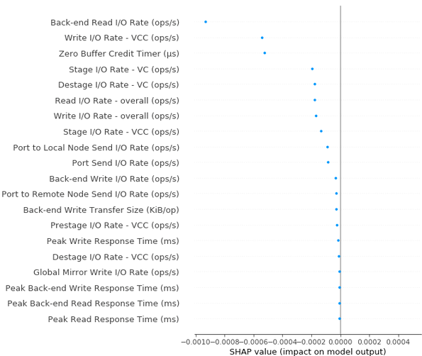
Explainability with SHAP: Feature Importance (2)
Validated data set, Cluster 2, 59 samples:
Cluster 2 also only has features with negative SHAP values of SHAP values of zero
I/O related metrics are most important features
Third most important feature is Zero Buffer Credit Timer (after weighting down)
Cluster 2 potentially represents non-actionable anomalies

Slide 15
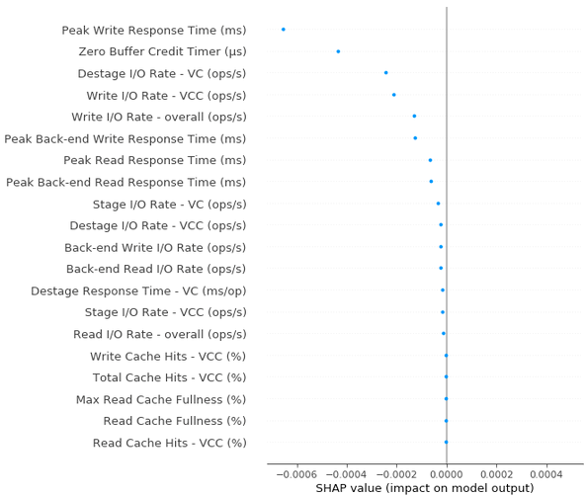
Explainability with SHAP: Feature Importance (3)
Validated data set, Cluster 3, 14 samples:
Response time related metric is the most important feature with SHAP value (< −0.0006)
Peak Write Response Time is contributing the most towards anomalous behaviour of the anomalies in that cluster
I/O rate related metrics with comparatively smaller SHAP values
Response Time being important together with Zero Buffer Credit Timer might indicate problem (e.g. congestion)
Cluster 3 potentially represents actionable anomalies

Slide 16
Explainability with SHAP: Temporal Importance (1)
One anomaly (82 time steps) from cluster 2 from validated data set:
Feature category “Cause”:
Features that can cause a negative impact on the system
E.g.: I/O Rates, Response Times

Slide 17
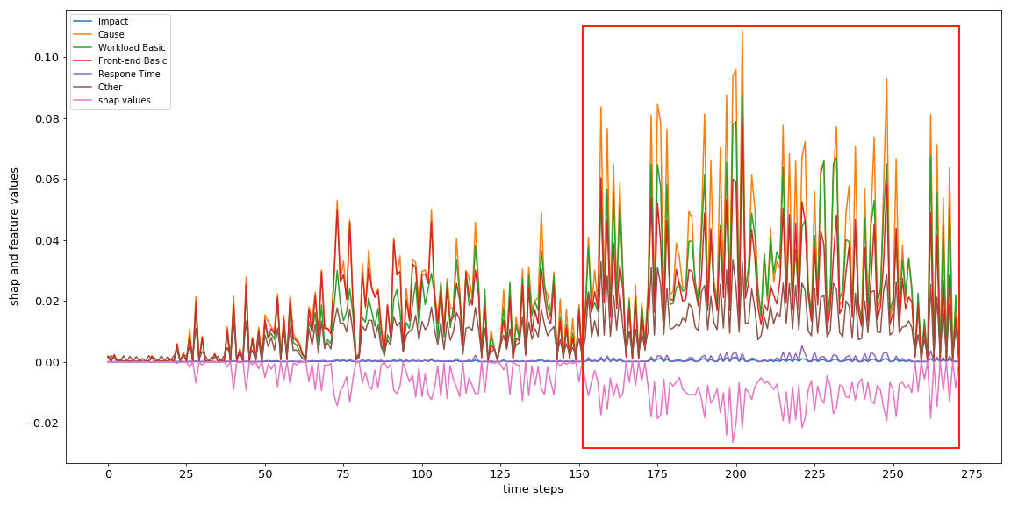
Explainability with SHAP: Temporal Importance (2)
Importance averaged over all anomalies within cluster 1 from validated data set:

Slide 18
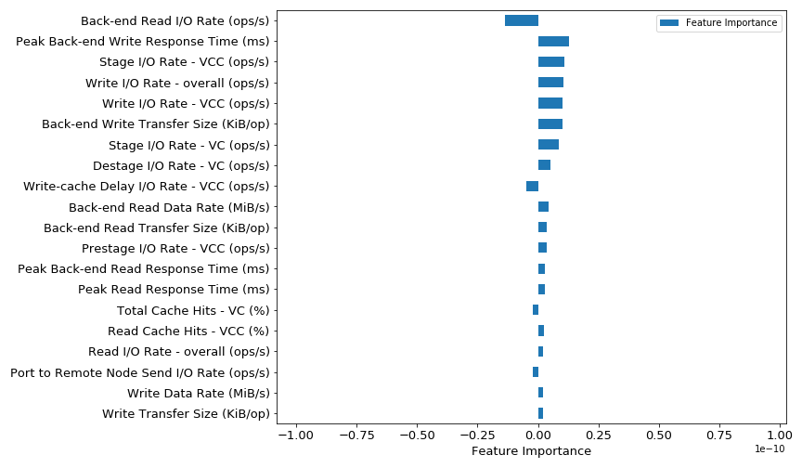
Explainability with Permutation Feature Importance (1)
Validated data set, Cluster 3, 64 samples:
Features that contribute towards anomalous behaviour (negative values) and normal behaviour (positive values)
Back-end Read I/O Rate and Write-cache Delay I/O Rate contribute the most towards the anomalies
Positive values for Back-end Write Transfer Size indicate data traffic for anomalies during read operations → non-critical change in workload
Cluster 3 potentially represents non-actionable anomalies
*scale of 10⁻¹⁰

Slide 19
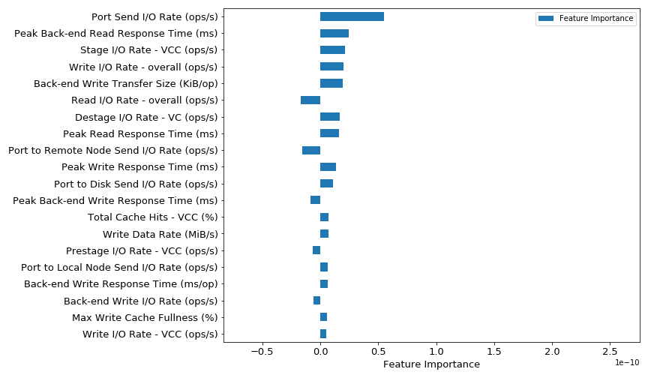
Explainability with Permutation Feature Importance (2)
Validated data set, Cluster 2, 4 samples:
Port to Remote Node Send I/O Rate contributing towards anomalies → indicate saturation of network traffic between nodes
Most of I/O related metrics are contributing towards normal behaviour
Cluster 2 potentially represents non-actionable anomalies
*scale of 10⁻¹⁰

Slide 20
Summary
Conclusions:
Encoder-only architecture with integrated silhouette score during training generates meaningful clusters of anomalies
Autoencoder architecture needed for model-agnostic explainability methods
Clustering in combination with domain expertise provides more useful explanations
Feature explanations using SHAP and Feature Permutation show potential signatures of anomaly clusters: Actionability and non-actionability
Outlook:
More non-validated data that better reflects different types of anomalous behaviour
Clustering of different storage systems: Clusters based on system family and model showing potentially new signatures
Generate explanations for normal behaviour
Time-based signatures of anomalies with temporal explanations

Slide 21
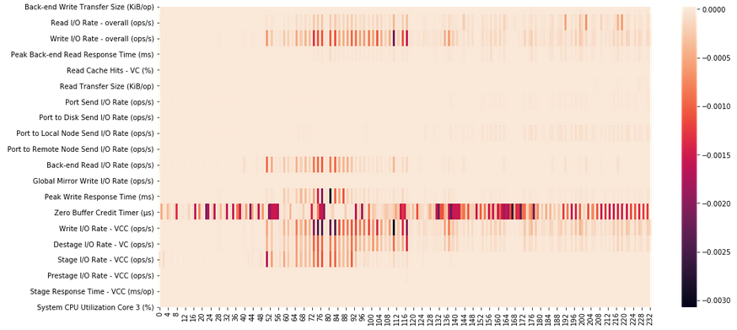
Combination of Feature and Temporal Explanation
Heatmap showing feature and time step important at the same time → feature importance per time step
Does not provide intuitive explanations
Top 20 Features
One anomaly with 232 time steps

